Slide 1
Collaborative Team Science to Advance New Therapies for Epilepsy “The CURE Infantile Spasms and Epilepsy Genetics Initiatives”
www.CUREepilepsy.org
Notes:
Since our inception in 1995, CURE has raised $28 million, awarding 166 research grants in 13 countries.
Invest 88% of our funds in our mission.

Slide 2
Why infantile spasms?
Seizures are stereotypical, thus making diagnosis more clear compared to other seizure types
Prognosis is particularly poor and frequently results in life-long developmental disability (need for better therapies)
Atypical EEG serves as a predictive biomarker that can be used to track success of therapy
Animal models are available that can be used for the early identification of new therapies
Success can be measured in the short term; years vs. decades

Slide 3
PROGRAM GOAL
To support collaborative, milestone‐driven efforts that advance the understanding of the underlying pathology of infantile spasms and lead to the development of a disease‐modifying therapy or cure for infantile spasms.
Notes:
This was our stated program goal. The key words are noted in red – collaborative and milestone-driven. Milestone-driven was particularly important for us as it meant the science would drive the direction. At any time, we could and would refocus the team based on new data.

Slide 4
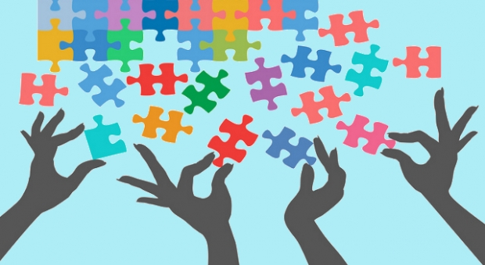
Collaborate
Share
Critique
Notes:
The key to this team working comes down to three things: Collaborate, Share, and Critique. We do this by hosting investigator meetings approximately twice a year. I’ll also mention that before a single dollar was paid to any investigator, we brought the 8 PIs together with CURE staff and our volunteer advisory panel for a meeting in which each investigator presented their proposal as written. As a group, we then critiqued and discussed which experiments should be the first priority. This kind of feedback that occurred before a single experiment was done was crucial and created “buy-in” from the team members at the outset. Our investigator meetings that have taken place since have been equally as influential. We share data, compare data, and suggest alternative strategies. Additionally, we’ve brought in other experts and “outsiders”, if you will, to challenge us and add new perspectives.

Slide 5
What is EGI?
EGI will create a data repository of clinical exome and genome sequences
Data will be reanalyzed every 6 months for novel genetic changes
New results will be communicated back to patients via their doctor
Data will also be made available to advance epilepsy research
Unique Partnership between CURE, Epi4K Investigators, NINDS, enrollment sites and The John and Barbara Vogelstein Family Foundation

Slide 6
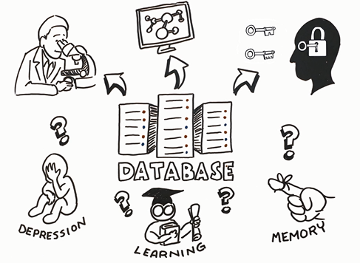
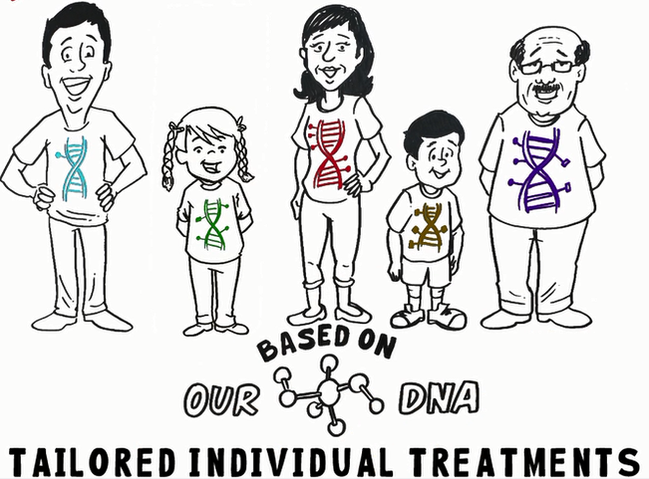
EGI Vision

